Slide 1
THE MEDIA OF MASS COMMUNICATION
11th Edition
John Vivian
PowerPoint™ Prepared by Amy M. Carwile
Texas A&M University at Texarkana
This multimedia product and its contents are protected under copyright law. The following are prohibited by law:
any public performance or display, including transmission of any image over a network;
preparation of any derivative work, including the extraction, in whole or in part, of any images;
any rental, lease, or lending of the program.

Slide 2
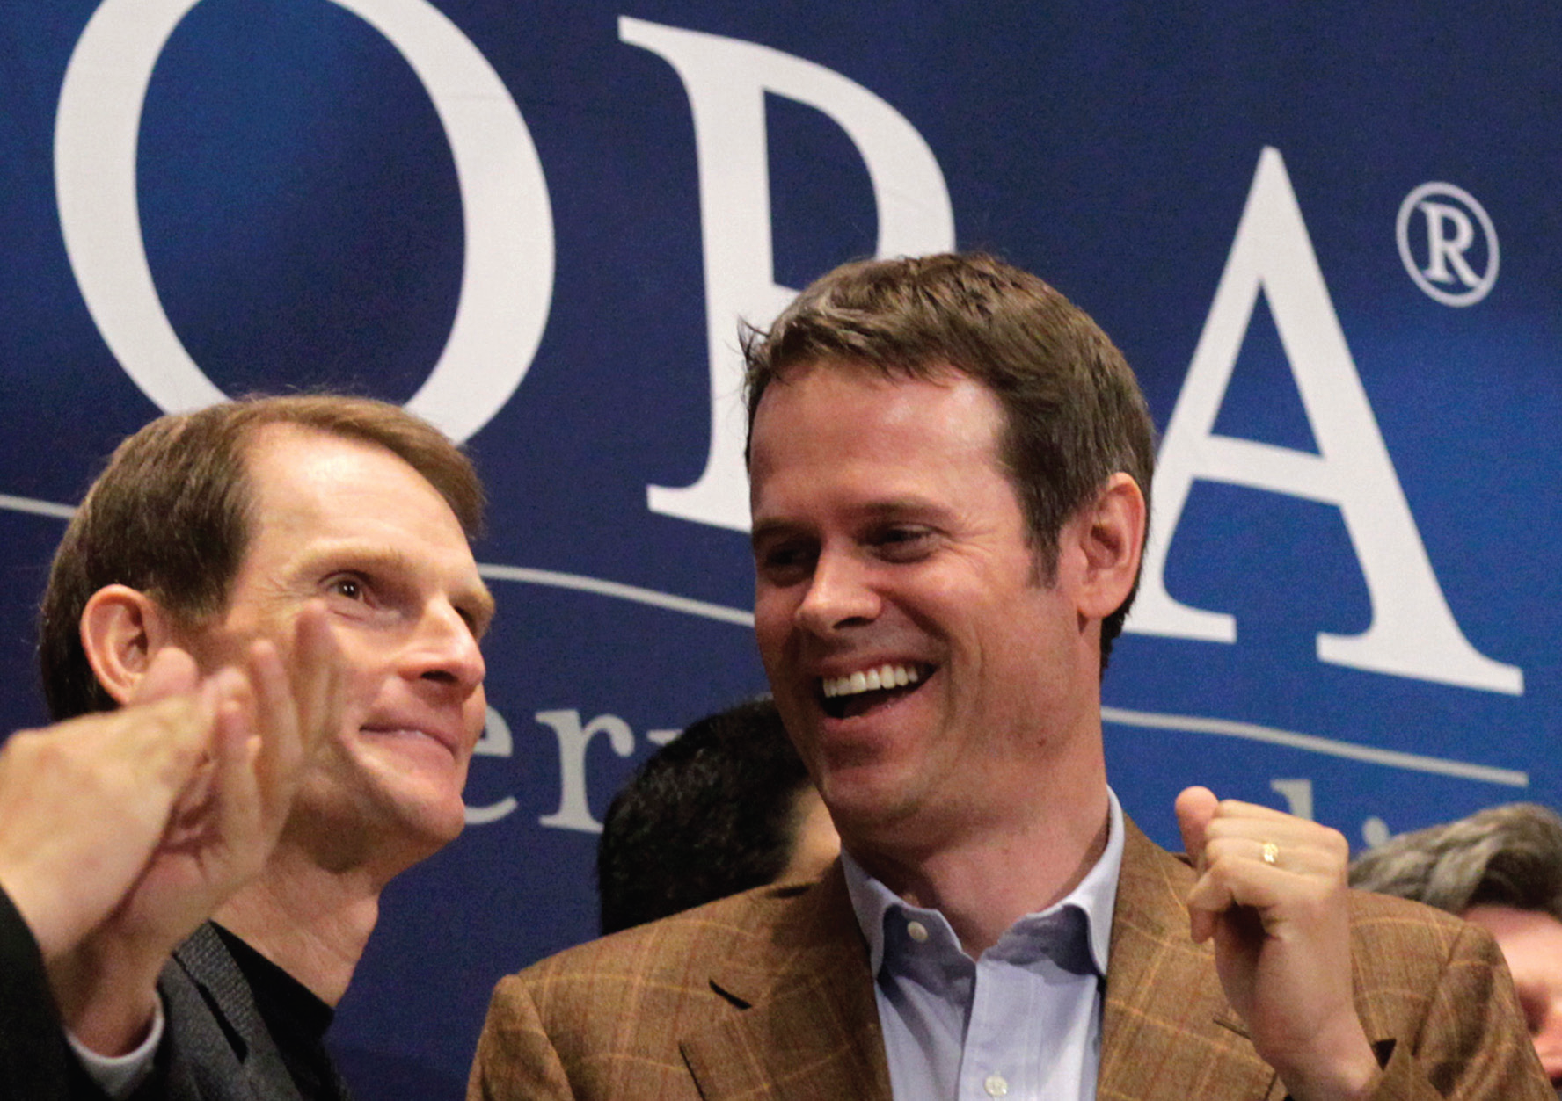
Chapter 5: Sound Media
  Thematic Chapter
  Overview
  Media Technology
  Media Future
  Media Economics
  Media & Democracy
  Elitism & Populism
  Media & Culture

Slide 3
Long Term Symbiosis
Airplay Marketing
  Radio time devoted to a particular recording
Programming Efficiency
  Cultural Fallout
  Payola
  Playlist

Slide 4
What is the financial interdependence of the music and radio industries
How do you evaluate the cultural implications of the symbiosis of the music and radio industries?
How about the cultural implications of payola?

Slide 5
Recording Industry
Big Four
 | Annual Revenue | Parent Company | Headquarters | Labels
Universal Music | $6.1 billion | Vivendi | France | Decca, Def Jam, Geffen, Interscope, Island, MCA, Motown, Verve
EMI | $1.6 billion | Citigroup | United States | Bluenote, Capitol, EMI, Liberty, Venture, Virgin
Warner Music | $3.0 billion | Access Industries | United States | Asylum, Atlantic, Bad Boy, Elektra, Lava, Nonesuch, Rhino, Warner
Sony Music (BMG) | $1.1 billion | Sony | Japan | Columbia, Epic, Legacy, Odyssey, Provident, RCA, Sony

Slide 6
Recording Industry (continued)
File Swapping Blow
  Shawn Fanning
  Napster
iTunes Recovery
  Kazaa
  Morpheus
  Grokster
  RIAA

Slide 7
If you were a Big Four executive, where would you look to grow your company?
To what extent do you regard Shawn Fanning as a folk hero? Or a criminal who facilitated the theft of legitimate income from composers, lyricists, performers and recording companies?
How would you rate iTunes 99-cent-a download charge for a song? High? Optimal? Low?

Slide 8
Radio Industry
Government Licensing
  Federal Radio Act
  Ownership Limits
  Technical Restrictions
  Content Requirements
    Public Interest
    Convenience
    Necessity
Trusteeship Concept
  First Amendment
  Trusteeship vs. Marketplace concepts

Slide 9
How do you regard the argument that government regulation of the U.S. radio industry came about for common-sense reasons?
Do you favor marketplace forces as the sole regulator of radio? Or is government better positioned as a regulator? Or do you favor a marketplace-government hybrid?

Slide 10
POINT
  The record industry has only itself to blame for declining prospects.
  It was too cozy, too smug, too long with an outdated business model.
  Stop griping.
  Adjust to the new reality.
COUNTERPOINT
  Music is at the heart of a vibrant modern culture.
  The recording industry’s survival is essential.
  Its financial well-being must be protected.

Slide 11
Characteristics of U.S. Radio
Radio Infrastructure
  Advertising
  Ownership Limits
    1996 Telecommunications Act
      Ended most limits on chain ownership
  Localism
  Two-tier Infrastructure

Slide 12
Scope of Radio Industry
Two technologies
  Frequency Modulation (FM)
  Amplitude Modulation (AM)
Public Radio
Radio Chains

Slide 13
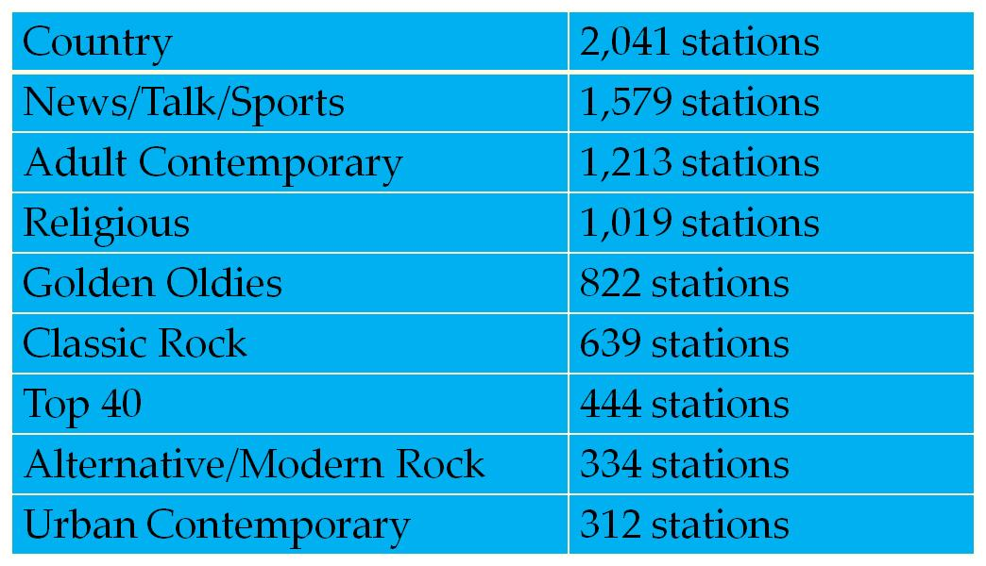
Radio Station Formats

Slide 14
What changes do you see occurring in the shape of U.S. radio industry?
How do you differentiate radio networks from radio chains?

Slide 15
Influence of Radio
Ubiquity
  22 hours per week
  520 million radio sets in the U.S.
  More people receive news from radio than from any other medium
  Switch to iPods, satellite services, webcasts, and cell phones

Slide 16
Radio Content
Entertainment
News
Loss of audience and advertisers to television
Switch to recorded music
Radio news forms
Breaking news
Headline services
All-news
News packages
Decline of radio news

Slide 17
Radio Content (continued)
Talk Radio
Public Radio
Rush Limbaugh
Talk Shows
  Political Talk Show Audiences
    White
    Male
    Republican
    Financially well-off
    More politically engaged than average Americans
    Distrustful of mainstream media outlets
Corporation for Public Broadcasting
  1967 Public Broadcasting Act
  All Things Considered
  Morning Edition
  The Takeaway
  American Public Media

Slide 18
How has radio lost its competitive edge as a source for music?
Where can you find radio news these days?
How is talk radio different from news radio?
How is public radio a formidable and growing component of the U.S. radio industry?

Slide 19
Radio Industry Directions
Satellite Radio
Terrestrial Radio
New Technologies
  iPod
  Podcasting
  On-demand Radio

Slide 20
What might revitalize locally licensed terrestrial commercial radio?
What are your music habits? MP3 devices like iPods? Or over-air stations? How about podcasts? How about on-demand radio?
What attracts you to one more than the other?

